Slide 1
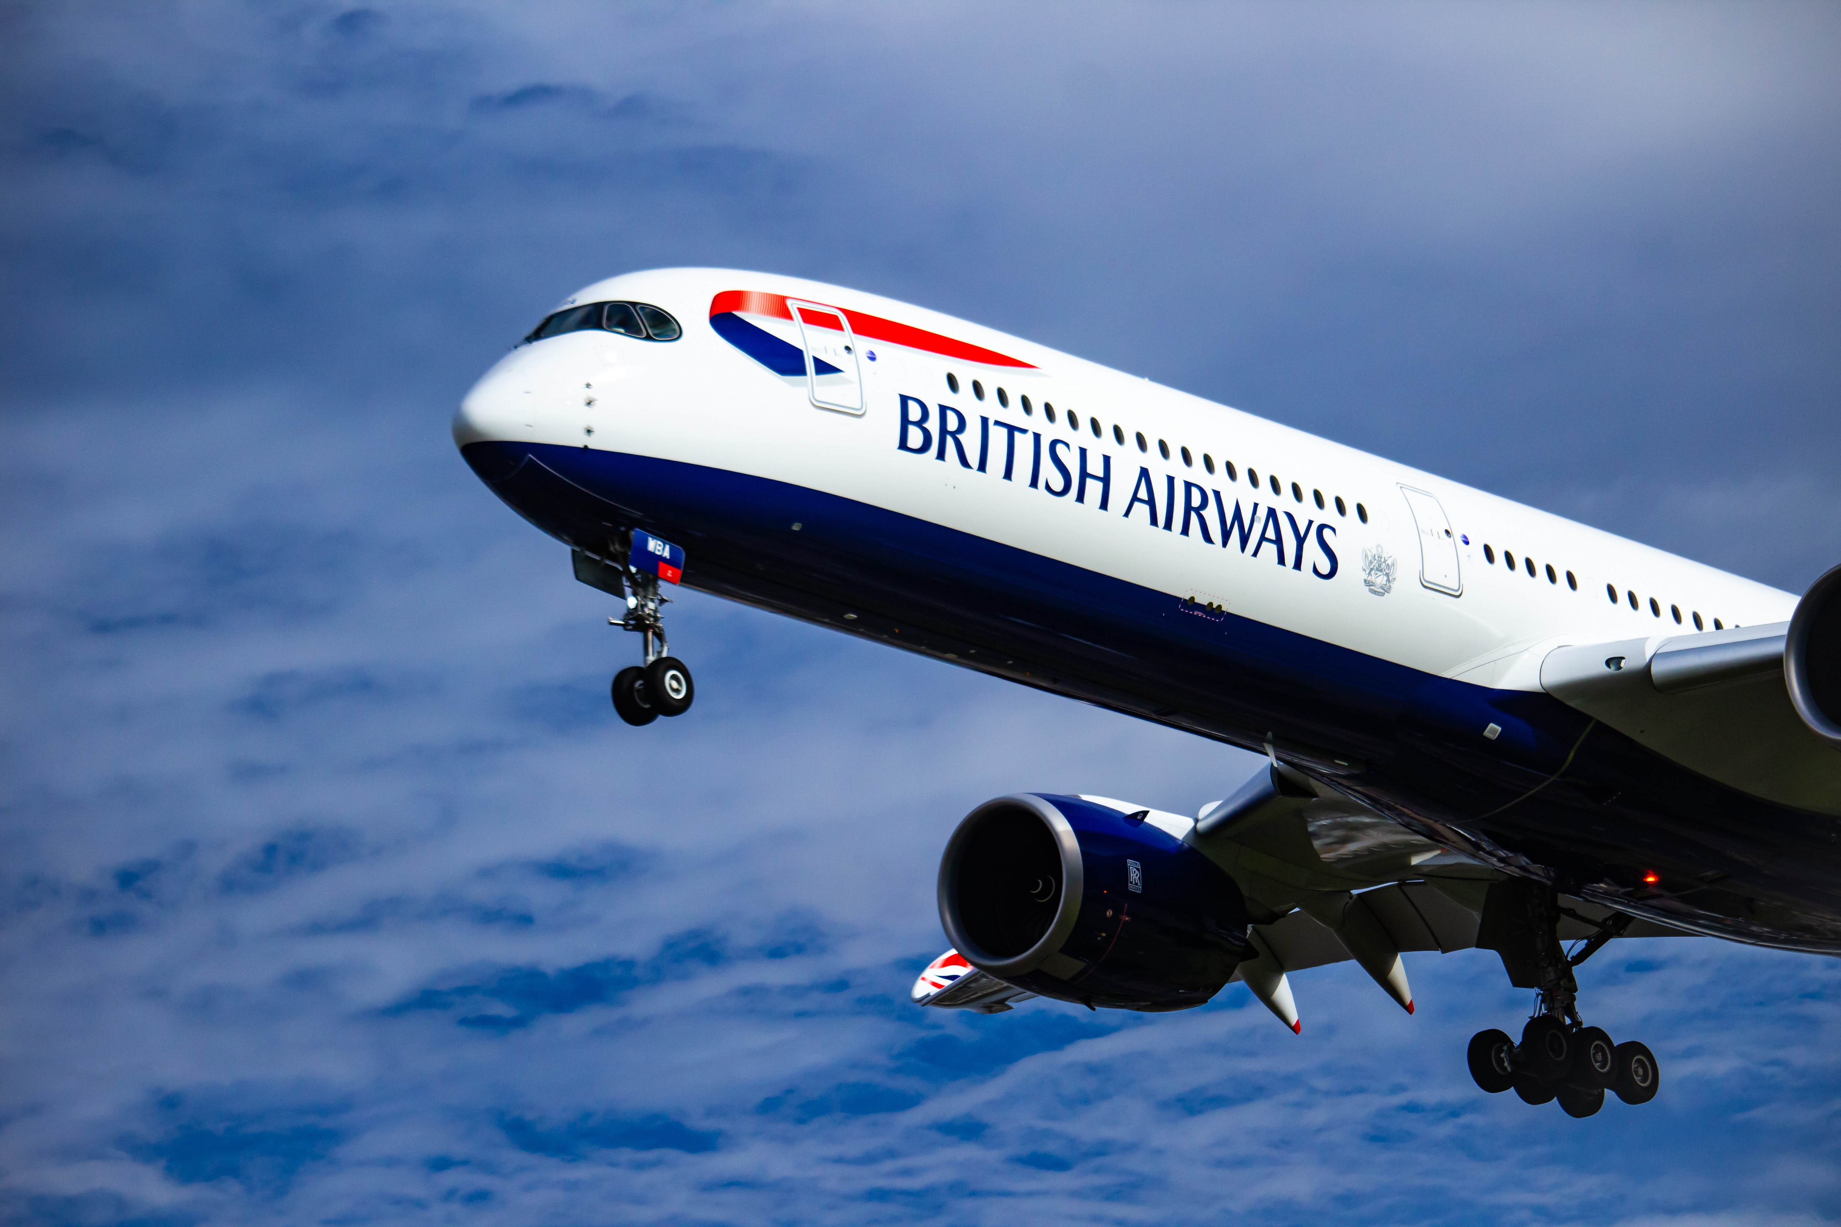
Unveiling Customer Sentiments: A Brief Analysis
Navigating Positivity, Identifying Challenges, and Discovering Themes through Sentiment Analysis

Slide 2
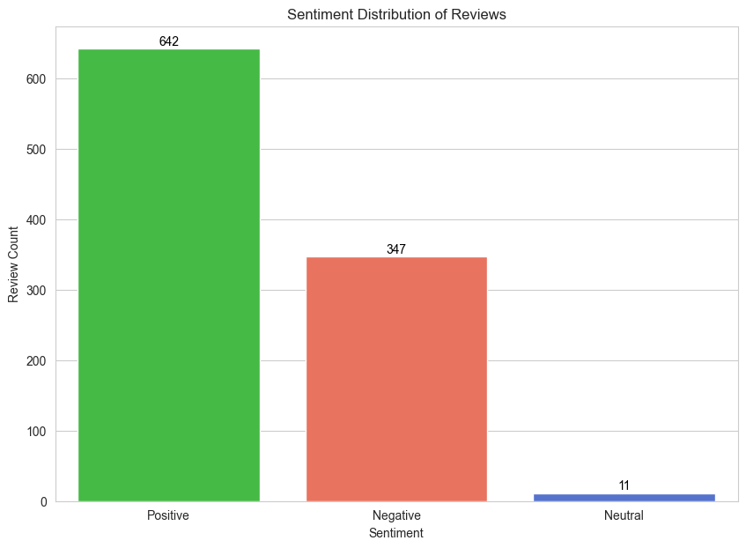
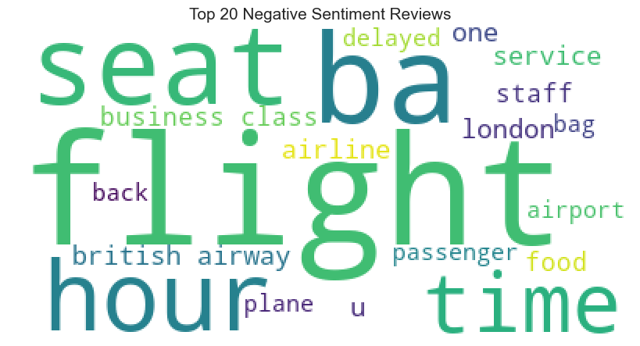
Sentiment Analysis from Customer Reviews
Key insights from top 20 negative sentiments reviews include dissatisfaction with flight schedules and seating comfort (time, delayed, seat), varying sentiments about in-flight meals (food), potential concerns with airline staff conduct (staff), and specific challenges related to flights or events in london (london).
The bar plot, based on 1000 customer reviews from Skytrax, reveals that 642 are positive, 347 are negative, indicating areas for improvement, and only 11 are neutral, suggesting decisive opinions.

